Slide 2
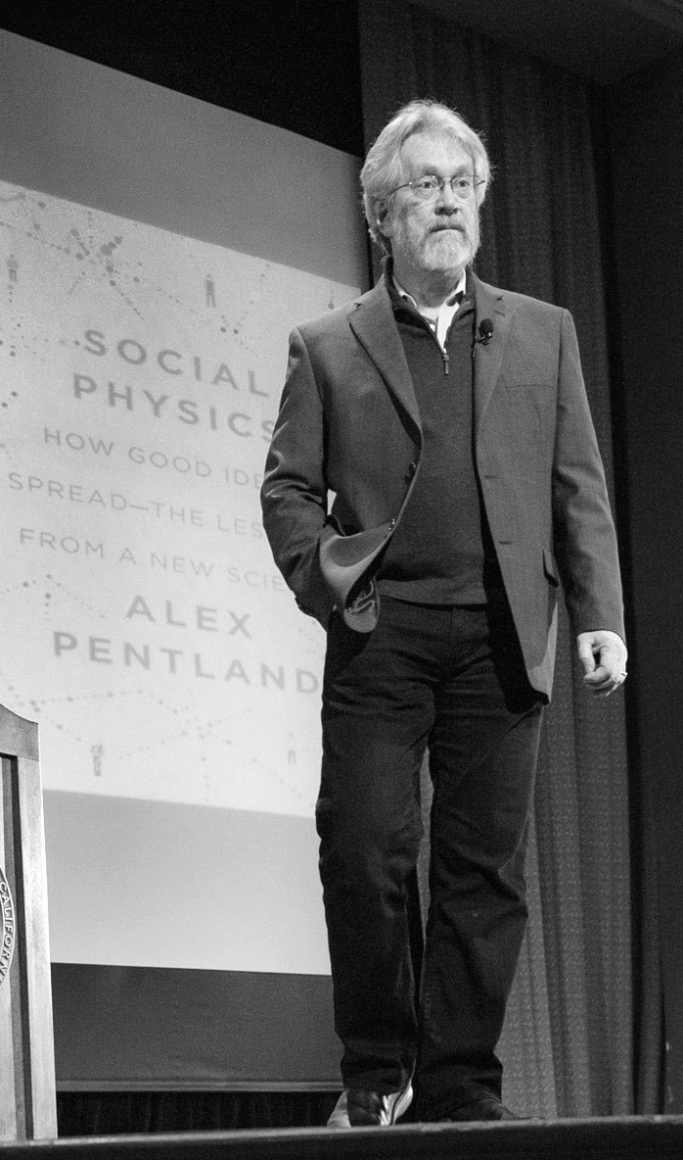



BACKED BY
USED BY
Inventing “Google” for predictive analytics
“World’s 7 strongest Data Scientists”
PARTNERS
Winner of the DARPA network challenge

Slide 3

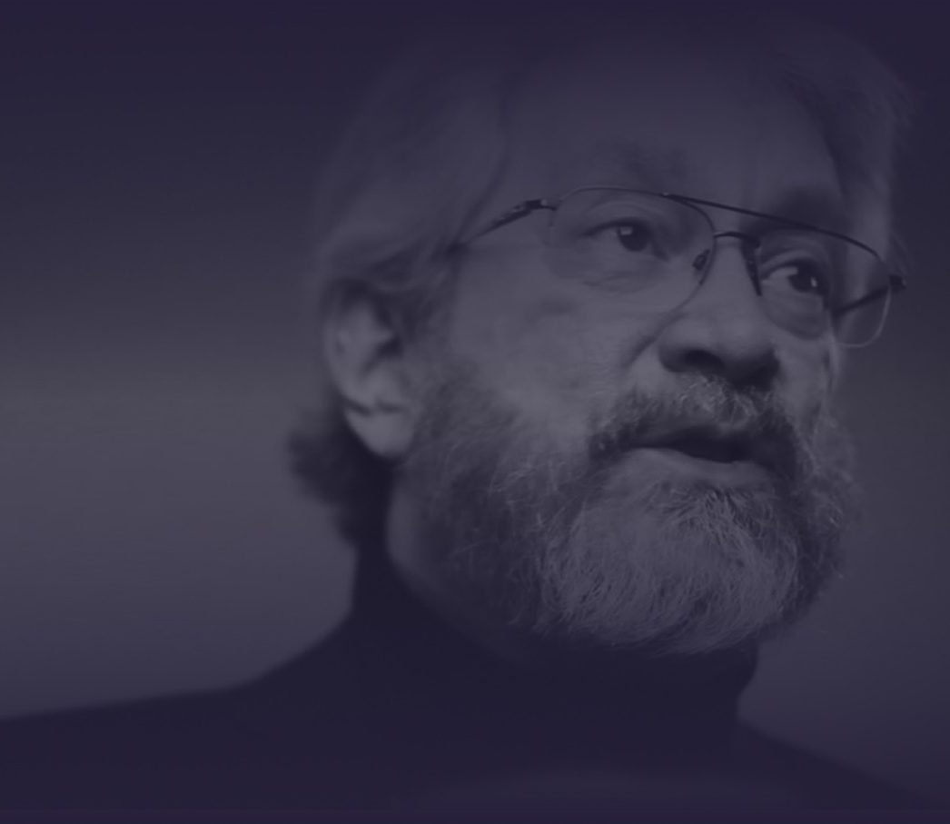

SOCIAL PHYSICs: THE SECRET SAUCE
Social Physics breaks the paradigm.
Instead of building a model per each predictive question, build ONE Social Sphere of human behavior and ask unlimited predictive questions.
This enables the automation of predictive science.
Technology pioneer

Slide 4


Slide 5
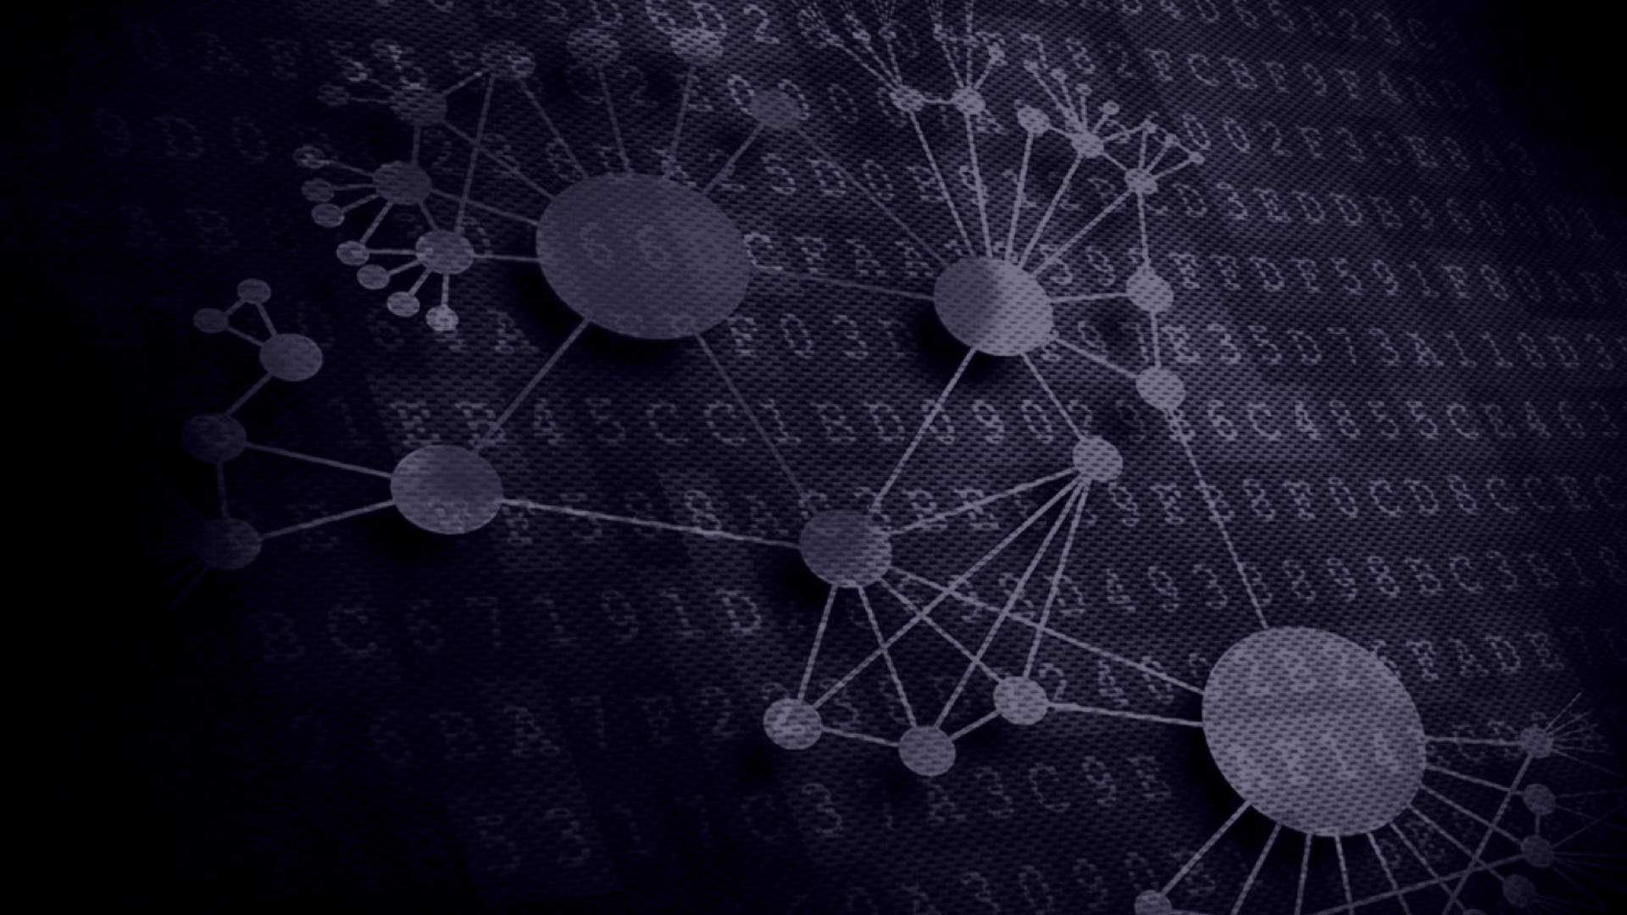


Social Physics breaks the paradigm
Instead of building a model per each predictive question, build one ”Social Sphere” of human behavior and ask unlimited predictive questions. This enables the democratization of predictive science.

Slide 8
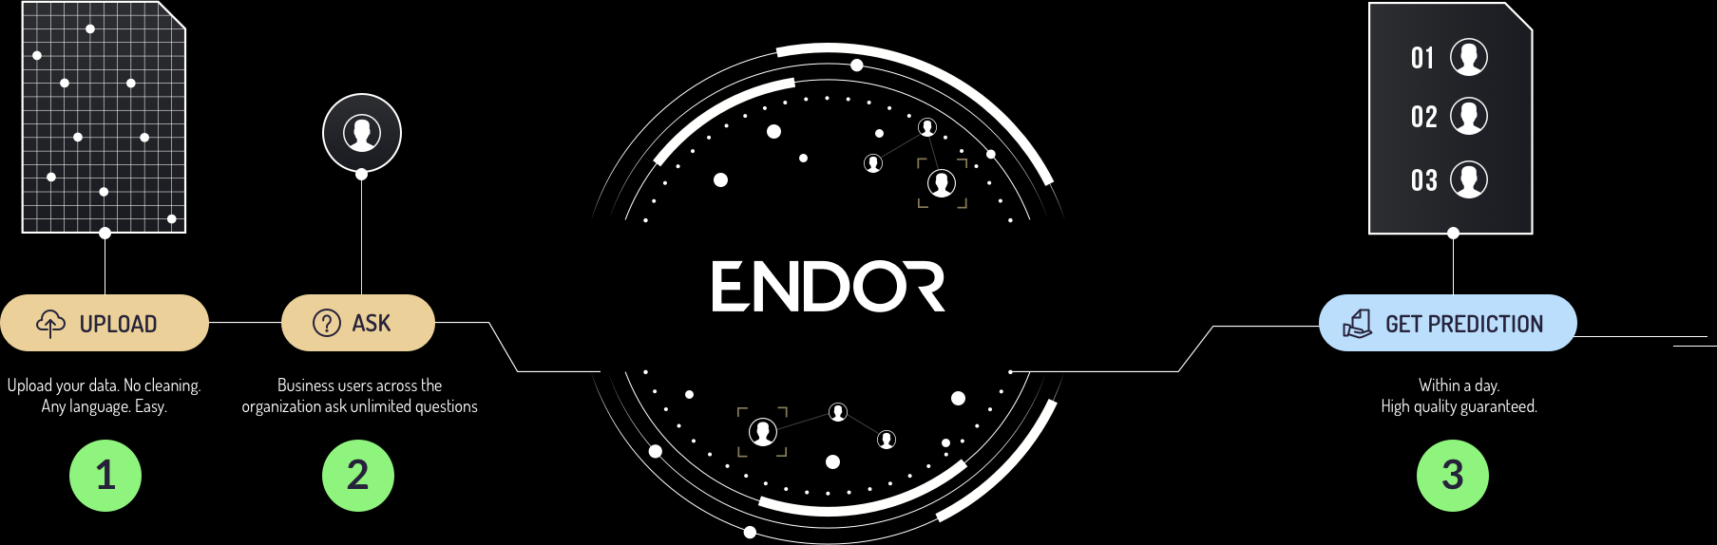
HOW DOES IT WORK
Boost growth based on automated accurate predictions
IN MINUTES, INSTEAD OF MONTHS
As simple as that.

Slide 9
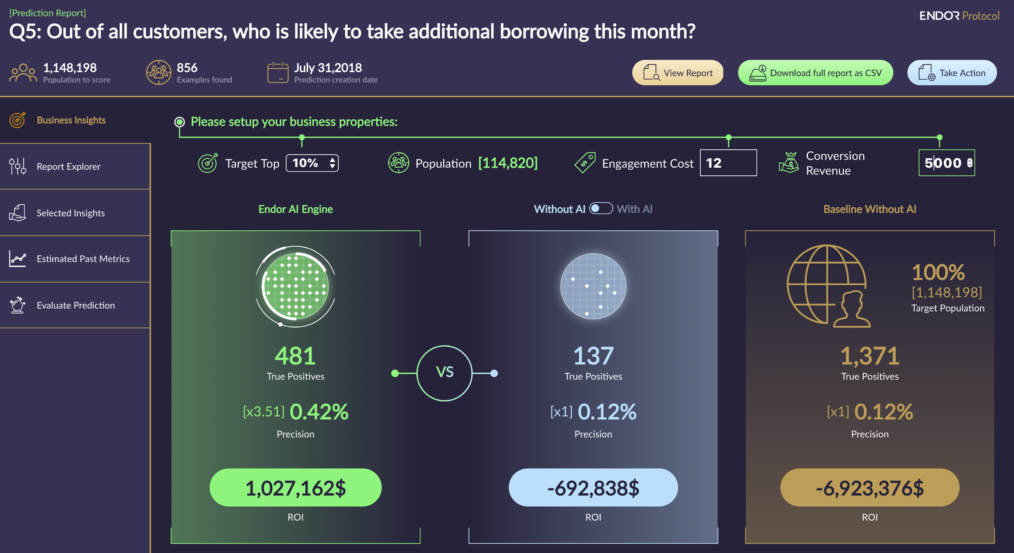
HOW DOES IT WORK

Slide 10
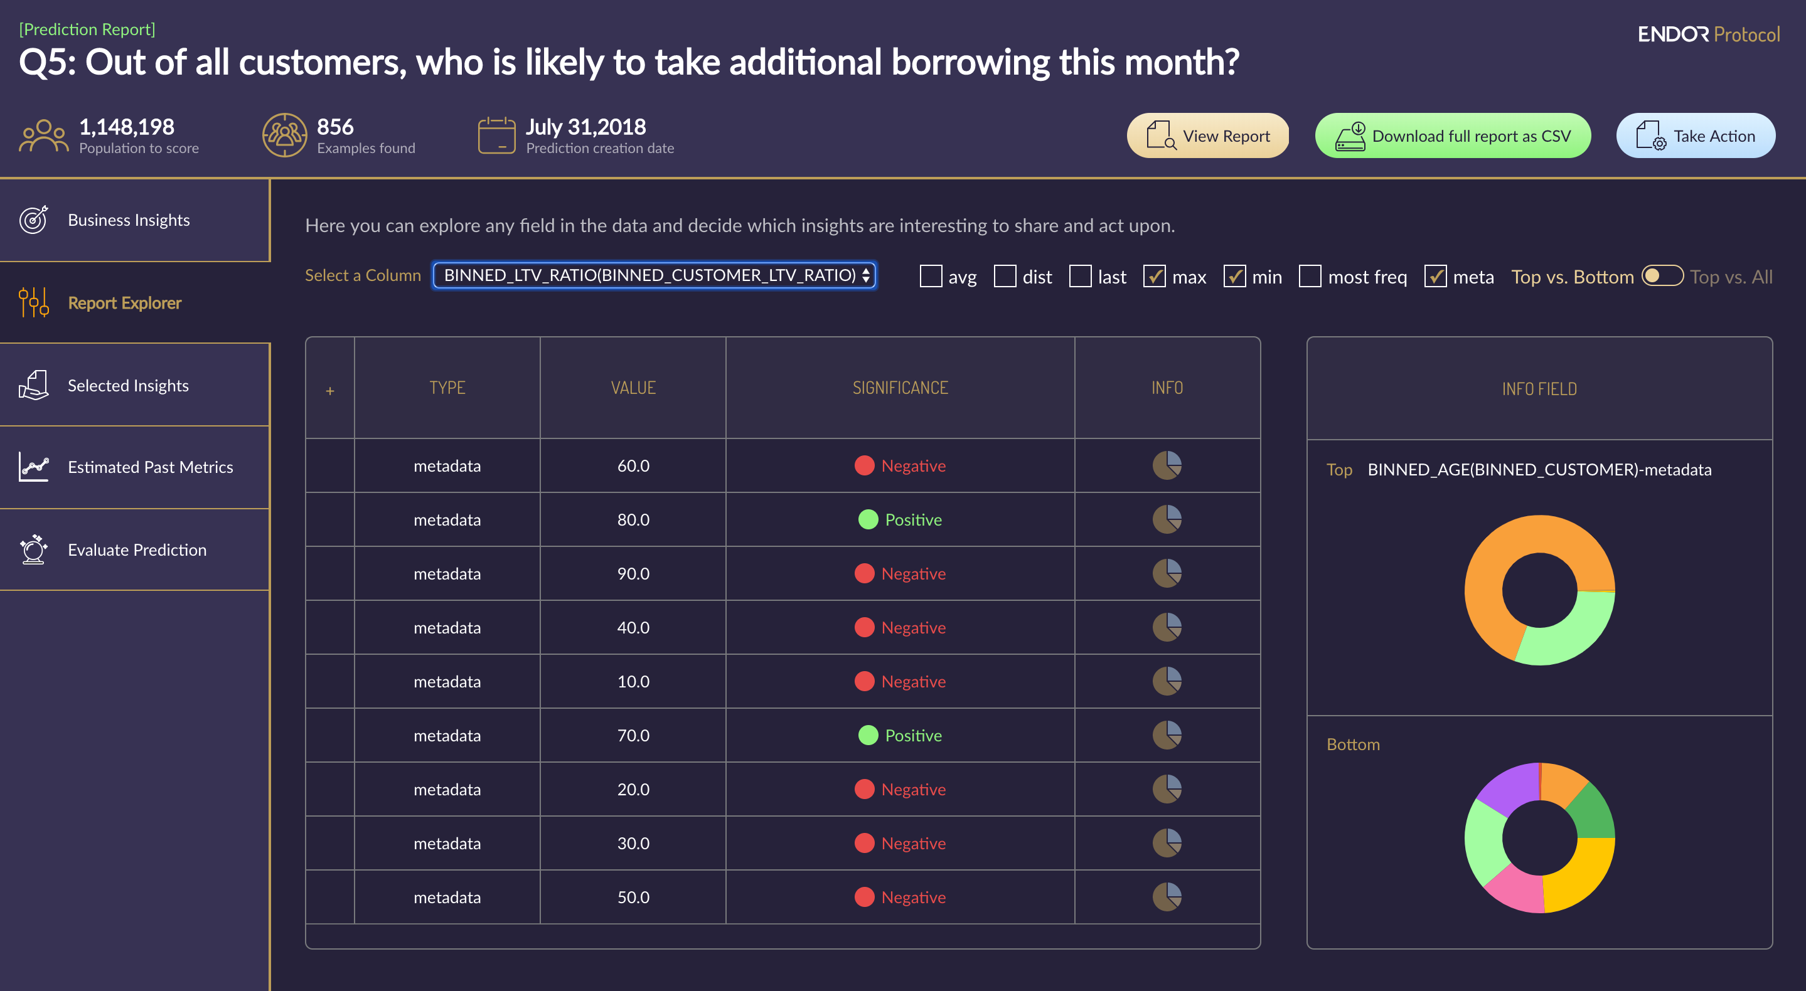
HOW DOES IT WORK

Slide 11
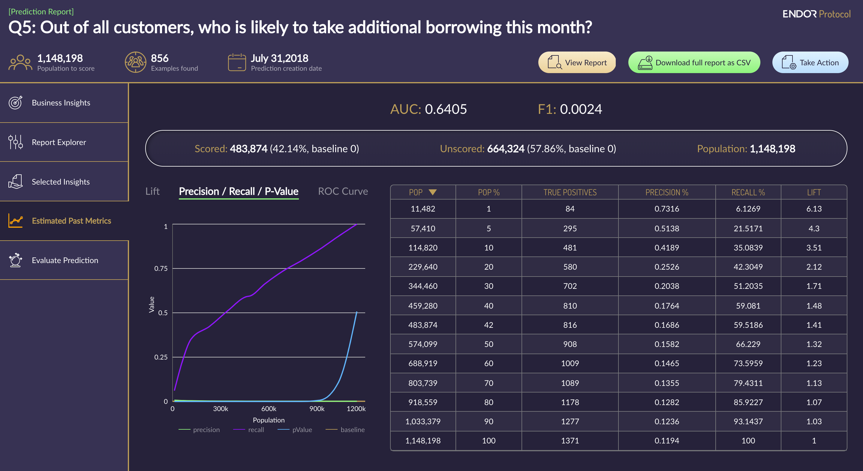
HOW DOES IT WORK

